Slide 1

SWE General Meeting: Professional Development
04/18/2013

Slide 2
Icebreaker
Break out to numbered groups!
Whoever is the most creative wins!

Slide 3
New Officers
Newsletter Editor: Christine Hawley
Ambassador: Tasnia Qazi
Membership/Public Relations: TBD
Mentorship Chair: TBD

Slide 4
Upcoming Events
Lockheed Martin Day 04/19
Professional Development Conference 04/20
Etiquette Dinner 04/24
JPL Tour 04/26
Evening Hike to the C 04/26
Evening With Industry 05/01
SHPE Bowling Tournament 05/09
Laser Tag! 05/17

Slide 5
Lockheed Martin Day
2013 Space Day event Friday, April 19, Jefferson Elementary School
4285 Jefferson Street in Riverside, CA 92504
8am – 245PM
Carpools leaving at 730 am & 11am
Activities: Borax Slime & Planetarium

Slide 6

Professional Development Conference
Networking
Communication
Handling Money
Professional Conversations
$30 for students

Slide 7
Theta Tau: Etiquette Dinner
April 24th (Next Wednesday)
6-9 PM
HUB 302
$10
Prepare for the Evening With Industry

Slide 8

JPL Tour
The tour will take place on Friday April 26th! We will be leaving from UCR at 1:00 pm and leaving JPL by 6:00 pm. The following disciplines of engineering will be covered: Aeronautic/Astronautics Electrical/Electronics Mechanical Computer Software Systems

Slide 9

Hike with SHPE & NSBE
April 26th
8PM
Meet at Bourns loading dock (bus stop)
Light snacks provided

Slide 10




Evening With industry (EWI)
May 1st Wednesday (In place of next general meeting)
HUB 302
6-9 PM
$ 10 or 15 for both EWI & Etiquette Dinner
And more..

Slide 11
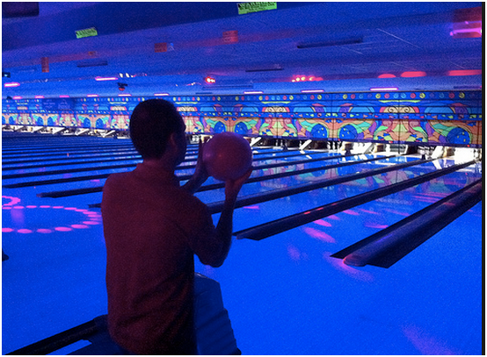
SHPE Bowling Tournament
Moreno Valley Brunswick
~9-12 PM
Let’s make a team

Slide 12
Laser Tag
Friday, May 17th (Week 7)
Start time: 5/6 pm
Where: WCH 205/206 & Second floor patio
Who: Everyone!!
How much? Prices to be announced.

Slide 13
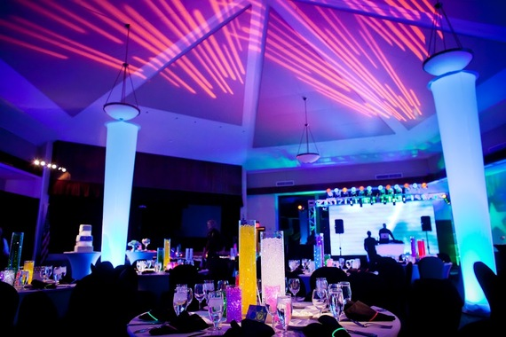
End of Year Banquet
Decorations
June 7th
Friday Week 10

